Slide 1
Analog & Digital Signals
Course Code: COE 3201
Course Title: Data Communication
Dept. of Computer Engineering
Faculty of Engineering
Lecture No: | 3 | Week No: | 3 | Semester: | Summer 19-20

Slide 2
Lecture Outline
Analog and Digital Data
Analog and Digital Signals
Time and Frequency Domains
Composite Signal
Bandwidth
Transmission Impairment
Signal-to-Noise Ratio (SNR)

Slide 3
Analog and Digital Data
Data can be
Analog
Digital
Analog data → information that is continuous
Example: sounds made by a human voice
Digital data → information that has discrete states
Example: data stored in computer memory (Os and 1s)

Slide 4
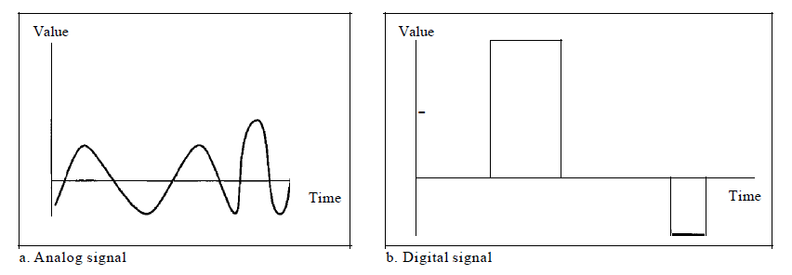
Analog and Digital Signals
Like the data they represent, signals can be either
Analog
Digital
Analog signals can have an infinite number of values in a range
Digital signals can have only a limited number of values

Slide 5
Periodic and Nonperiodic Signals
Both analog and digital signals can take one of two forms:
Periodic
Nonperiodic → Refer to as aperiodic, prefix a in Greek means "non“
Periodic signal
Completes a pattern within a measurable time frame, called a period, and
Repeats that pattern over subsequent identical periods
Completion of one full pattern is called a cycle
Nonperiodic signal changes without exhibiting a pattern or cycle
Both analog and digital signals can be periodic or nonperiodic
Commonly use: periodic analog signals (need less bandwidth) and nonperiodic digital signals (can represent variation in data)

Slide 6
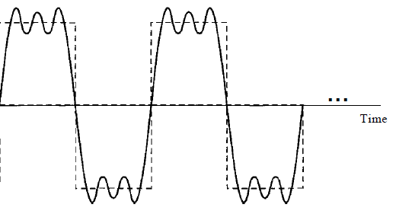
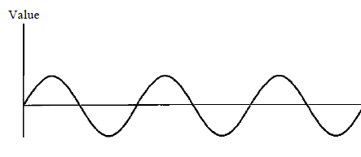
Periodic Analog Signals
Periodic analog signals can be classified as
Simple or
Composite
Simple periodic analog signal cannot be decomposed into simpler signals → a sine wave
Composite periodic analog signal is composed of multiple sine waves
Fig: Simple signal
Fig: Composite signal

Slide 7
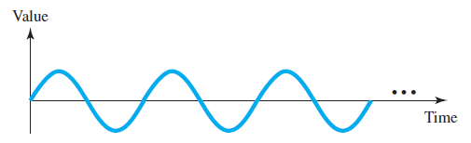
Sine Wave
Sine wave is the most fundamental form of a periodic analog signal
Its change over the course of a cycle is smooth and consistent, a continuous, rolling flow
A sine wave can be represented by three parameters: the peak amplitude, the frequency, and the phase
Fig: Sine wave

Slide 8

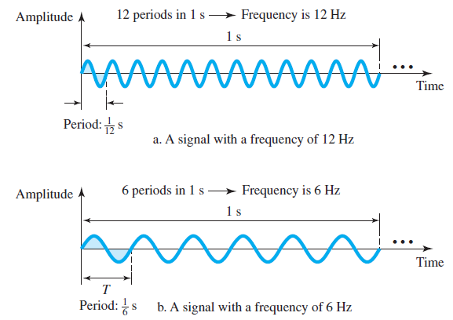
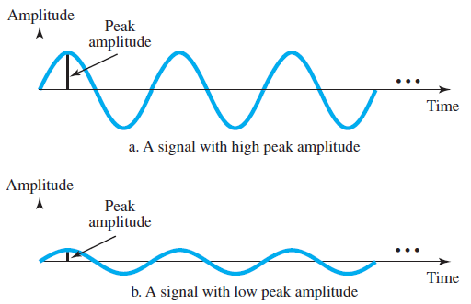
Peak Amplitude
is the absolute value of its highest intensity
proportional to the energy it carries
Frequency refers to the number of periods in 1 s. Note that period and frequency are just one characteristic defined in two ways.
Period is the inverse of frequency, and frequency is the inverse of period
Frequency is formally expressed in Hertz (Hz), which is cycle per second.

Slide 9
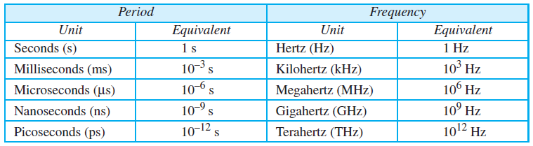
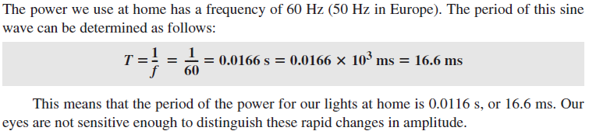
Units of period and frequency
Example:

Slide 10
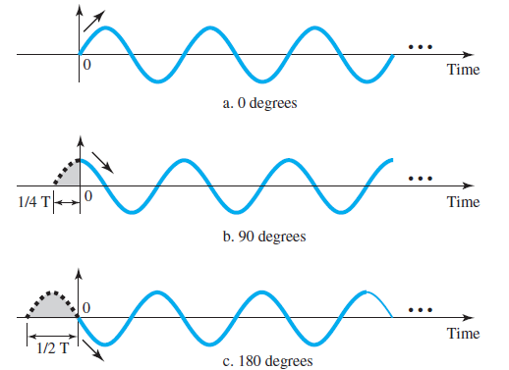
Phase
Phase describes the position of the waveform relative to time 0
Phase is measured in degrees or radians [360° is 2π rad; 1° is 2π/360 rad, and 1 rad is 360/(2π)]
A phase shift of 360° corresponds to a shift of a complete period;
A phase shift of 180° corresponds to a shift of one-half of a period
A phase shift of 90° corresponds to a shift of one-quarter of a period
Fig: Three sine waves with the same amplitude and frequency, but different phases

Slide 11
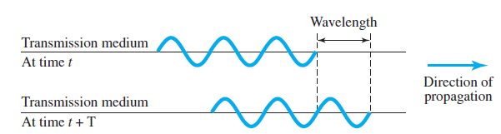
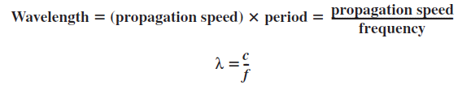
Wavelength
Wavelength is another characteristic of a signal traveling through a transmission medium
Wavelength binds the period or the frequency of a simple sine wave to the propagation speed of the medium

Slide 12
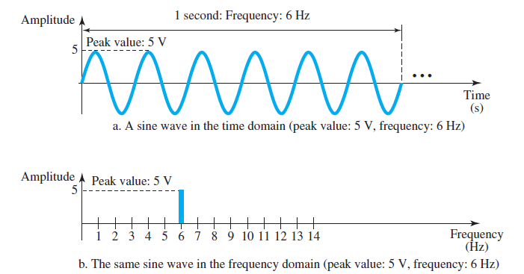
Time and Frequency Domains
Time-domain plot
Shows changes in signal amplitude with respect to time → amplitude-versus-time plot
Phase is not explicitly shown on a time-domain plot
Frequency-domain plot
To show the relationship between amplitude and frequency
Concerned with only the peak value and the frequency
Changes of amplitude during one period are not shown

Slide 13
Composite Signal
A single-frequency sine wave is not useful in data communications
Need to send a composite signal → a signal made of many simple sine waves
According to Fourier analysis, any composite signal is a combination of simple sine waves with different frequencies, amplitudes, and phases.
If the composite signal is periodic, the decomposition gives a series of signals with discrete frequencies
If the composite signal is nonperiodic, the decomposition gives a combination of sine waves with continuous frequencies

Slide 14
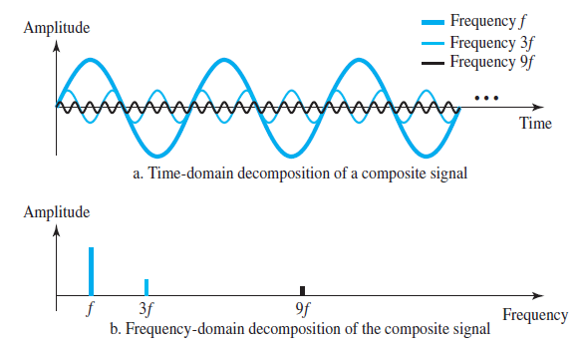
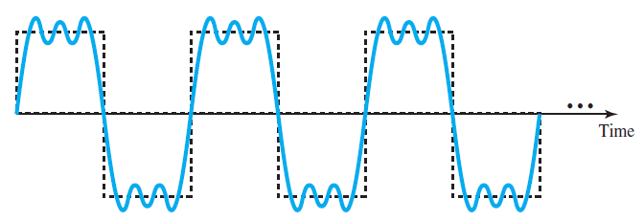
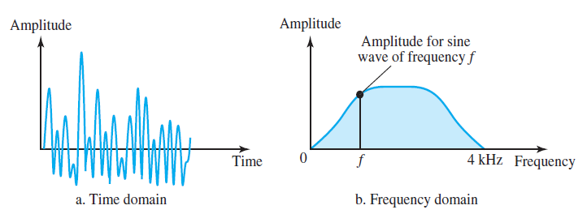
Periodic Composite Signal: can be decomposed into a number of signals with discrete frequencies in the frequency domain
Fig: A composite periodic signal
Fig: Decomposition of a composite periodic signal in the time and frequency domains
Nonperiodic Composite Signal: In a time-domain representation of this composite signal, there are an infinite number of simple sine frequencies

Slide 15
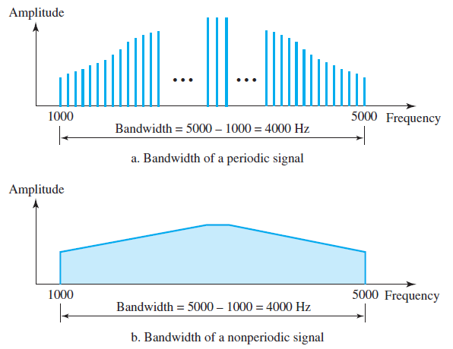
Bandwidth
The range of frequencies contained in a composite signal is its bandwidth
The bandwidth of a composite signal is the difference between the highest and the lowest frequencies contained in that signal
For example, if a composite signal contains frequencies between 1000 and 5000, its bandwidth is 5000 − 1000, or 4000
Fig: The bandwidth of periodic and nonperiodic composite signals

Slide 16
Practice Problem
Example: If a periodic signal is decomposed into five sine waves with frequencies of 100, 300, 500, 700, and 900 Hz, what is its bandwidth? Draw the spectrum, assuming all components have a maximum amplitude of 10 V.

Slide 17
Practice Problem
Example: Example: A periodic signal has a bandwidth of 20 Hz. The highest frequency is 60 Hz. What is the lowest frequency? Draw the spectrum if the signal contains all frequencies of the same amplitude.

Slide 18
Practice Problem
Example: A nonperiodic composite signal has a bandwidth of 200 kHz, with a middle frequency of 140 kHz and peak amplitude of 20 V. The two extreme frequencies have an amplitude of 0. Draw the frequency domain of the signal.

Slide 19
Practice Problem
Example: If a periodic signal is decomposed into five sine waves with frequencies of 100, 300, 500, 700, and 900 Hz, what is its bandwidth? Draw the spectrum, assuming all components have a maximum amplitude of 10 V.

Slide 20
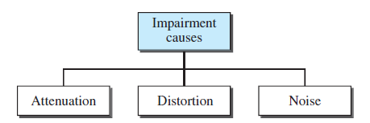
Transmission Impairment
Signals travel through transmission media, which are not perfect
The imperfection causes signal impairment
This means that the signal at the beginning of the medium is not the same as the signal at the end of the medium
Three causes of impairment are-
attenuation,
distortion, and
noise

Slide 21
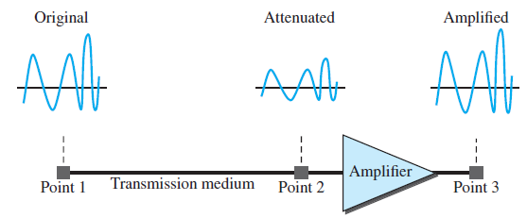
Attenuation means a loss of energy.
When a signal, simple or composite, travels through a medium, it loses some of its energy in overcoming the resistance of the medium.
Fig: Attenuation

Slide 22

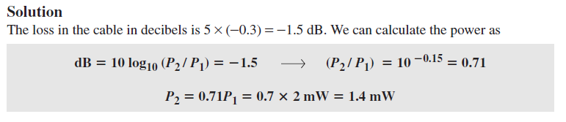
Decibel
To show that a signal has lost or gained strength, engineers use the unit of the decibel.
The decibel (dB) measures the relative strengths of two signals or one signal at two different points.
Variables P1 and P2 are the powers of a signal at points 1 and 2, respectively.
Note that the decibel is negative if a signal is attenuated and positive if a signal is amplified.
Example: The loss in a cable is usually defined in decibels per kilometer (dB/km). If the signal at the beginning of a cable with −0.3 dB/km has a power of 2 mW, what is the power of the signal at 5 km?

Slide 23
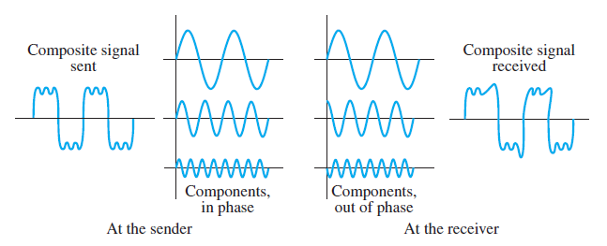
Distortion means that the signal changes its form or shape and can occur in a composite signal.
Each signal component has its own propagation speed through a medium and, therefore, its own delay in arriving at the final destination
Differences in delay may create a difference in phase if the delay is not exactly the same as the period duration.

Slide 24
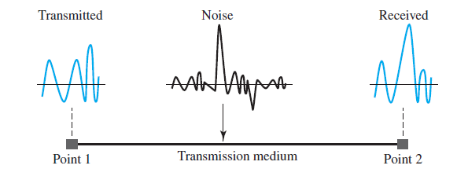
Noise is another cause of impairment.
Several types of noise,
Thermal noise → random motion of electrons in a wire, which creates an extra signal not originally sent by the transmitter
Induced noise→ comes from sources such as motors and appliances
Impulse noise → that comes from power lines, lightning, and so on

Slide 25


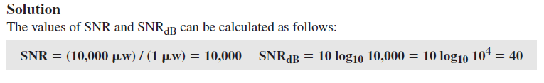
Signal-to-Noise Ratio (SNR)
To find the theoretical bit rate limit, we need to know the ratio of the signal power to the noise power. The signal-to-noise ratio is defined as
SNR is actually the ratio of what is wanted (signal) to what is not wanted (noise).
Because SNR is the ratio of two powers, it is often described in decibel units, SNR_{dB}, defined as
Example: The power of a signal is 10 mW and the power of the noise is 1 μW; what are the values of SNR and SNR_{dB}

Slide 26
Books
Forouzan, B. A. "Data Communication and Networking. Tata McGraw." (2005).

Slide 27
References
1. Prakash C. Gupta, “Data communications”, Prentice Hall India Pvt.
2. William Stallings, "Data and Computer Communications”, Pearson
3. Forouzan, B. A. "Data Communication and Networking. Tata McGraw." (2005).

